Slide 1

ETL Pipeline Monitoring

Slide 2

Contents
01
Approaches
Pg. No 03
02
Automate Notifications Using CloudWatch Log Subscription
Pg. No 04
03
Automate Notifications Using CloudWatch Alarms
Pg. No 08
04
Pros And Cons
Pg. No 12

Slide 3



Approaches
Approaches
CloudWatch Log Subscription
CloudWatch Alarms
Pros And Cons
Automate notifications using CloudWatch Log Subscription
Automate notifications using CloudWatch Alarms
Note: Desired state noted as per Week 1 meetings with DHL eCommerce stakeholders. Subject to change after additional iterative discussions and meetings

Slide 4
Automate Notifications Using CloudWatch Log Subscription
Approaches
CloudWatch Log Subscription
CloudWatch Alarms
Pros And Cons
For scenarios where we need specificity on the error in the notification, we can use a CloudWatch Logs subscription
CloudWatch Logs subscriptions let you match entries with a particular error pattern in your log and be notified with those error details
This approach walks you through how to configure a CloudWatch log subscription that triggers an AWS Lambda function to process the log
The Lambda function uses Amazon SNS to send an email with the specific error details and the log location
Overview

Slide 5
Prerequisites
Approaches
CloudWatch Log Subscription
CloudWatch Alarms
Pros And Cons
To deploy this solution, you need access to the AWS Management Console
You need permission to create IAM roles and policies, SNS topics, Lambda functions, and CloudWatch event rules
To implement this solution, you must create:
An SNS topic
An IAM role
A Lambda function
A CloudWatch log trigger

Slide 6
Solution Overview
Approaches
CloudWatch Log Subscription
CloudWatch Alarms
Pros And Cons
You have a bunch of Lambda functions whose specific critical errors you want to be notified about
CloudWatch Logs captures the logs from these Lambda functions
It invokes the “error processing” Lambda function when a log entry matches a filter pattern, for example, ERROR, CRITICAL, or a custom error
This error processing Lambda function in turn publishes a message to an Amazon SNS topic, to which can subscribe to get an email when the error occurs
Overview

Slide 7
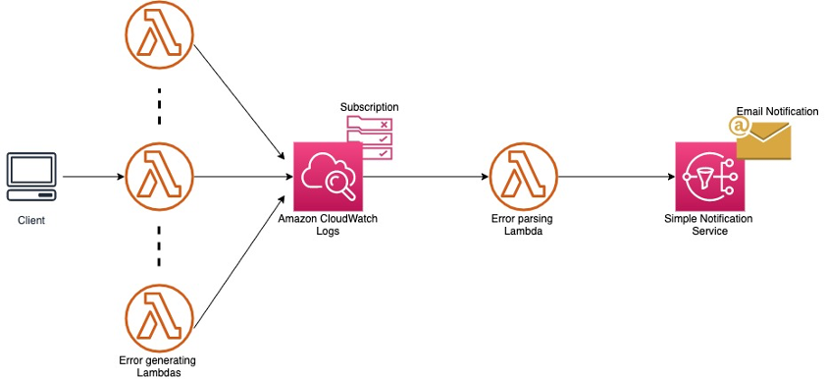
Architecture
Approaches
CloudWatch Log Subscription
CloudWatch Alarms
Pros And Cons

Slide 8
Automate Notifications Using CloudWatch Alarms
Approaches
CloudWatch Log Subscription
CloudWatch Alarms
Pros And Cons
This approach involves triggering notification whenever lambda function returns an error
Noting AWS Lambda logs error metrics to CloudWatch
CloudWatch alarm lets you configure on the Errors metric of your Lambda function to post a message to your Amazon SNS topic when AWS Lambda emits error metrics to CloudWatch
You subscribe to the Amazon SNS topics to get email notification
Overview

Slide 9
Prerequisites
Approaches
CloudWatch Log Subscription
CloudWatch Alarms
Pros And Cons
To deploy this solution, you need access to the AWS Management Console
You need permission to create IAM roles and policies, SNS topics, Lambda functions, and CloudWatch event rules
To implement this solution, you must create:
An SNS topic
An IAM role
A Lambda function
A CloudWatch Alarm

Slide 10
Solution Overview
Approaches
CloudWatch Log Subscription
CloudWatch Alarms
Pros And Cons
Create an Amazon SNS topic
Subscribe to the topic so you can get email notifications when a new message is posted to the topic
In Amazon CloudWatch, set an alarm on the Errors metric of your Lambda function to publish a message to your SNS topic when errors occur
Overview

Slide 11
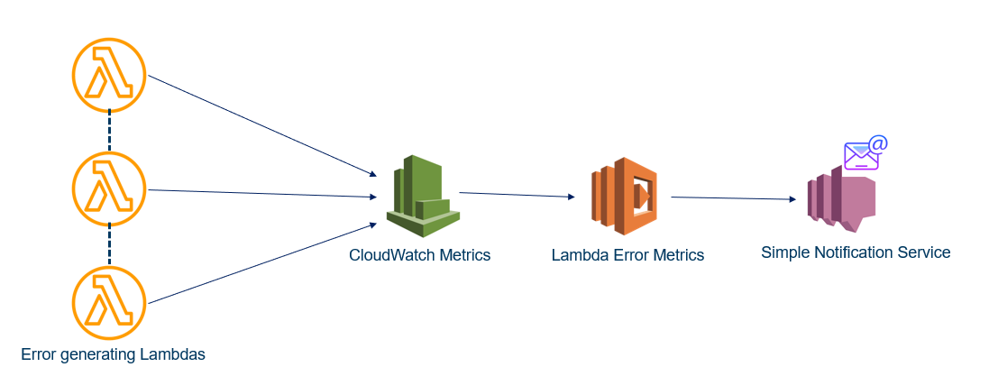
Architecture
Approaches
CloudWatch Log Subscription
CloudWatch Alarms
Pros And Cons

Slide 12
Pros And Cons
Approaches
CloudWatch Log Subscription
CloudWatch Alarms
Pros And Cons
CloudWatch Log Subscription
CloudWatch Alarms
Notification when an error occurs with a Lambda function
✓
✓
Specificity on the error in the notification
✓
✗
Let you match entries with a particular error pattern in your log and be notified with those error details
✓
✗
Trigger SNS across all lambda functions at once on error metrics
✗
✓

Slide 13

THANK YOU

